Slide 1
Forum: Micronutrients and Lipid metabolism
Panel Speakers
Microphone Controller: Anne Hu (Statistician)
Micronutrient Specialist: Jayden Abdallah & Laura Baker
Fat Specialist: Vanessa Shujie Chen
Lipid tolerance specialist: Jessica Rui Han
Statisticians: Jazlyn Lin & Pravin Radhakrishnan
The panel will be open for questions shortly after the presentation.

Slide 2
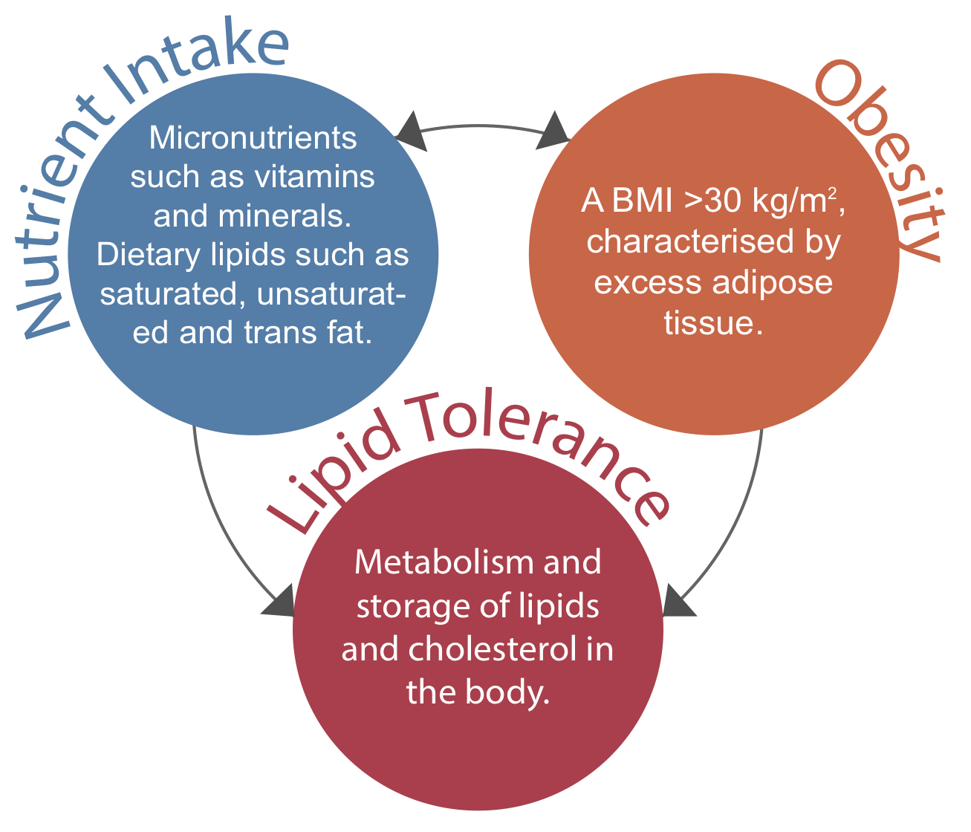




Aim & Main Results
MC: Good afternoon everyone, today we have a panel here discussing a recent study on obesity in the general Australian population. Specifically, the relationship between micronutrient and fat intake and how this affects lipid tolerance. Okay so starting off, what have we found?
Micro: We found that obese individuals tend to have lower intake of multiple micronutrients. Micronutrients were generally present in low-fat diets.
Fat: In general, saturated fats intake have been positively correlated with BMI whereas unsaturated fats intake have been negatively correlated with BMI.
Liptol: Obesity was associated with an impaired lipid tolerance presented by an increase in LDL cholesterol and triglycerides and decrease in HDL levels.
MC: Ah yes, since unsaturated fats and LDL are seen as “good lipids and good cholesterol” and the others are seen as bad. So tell me about the statistics.

Slide 3
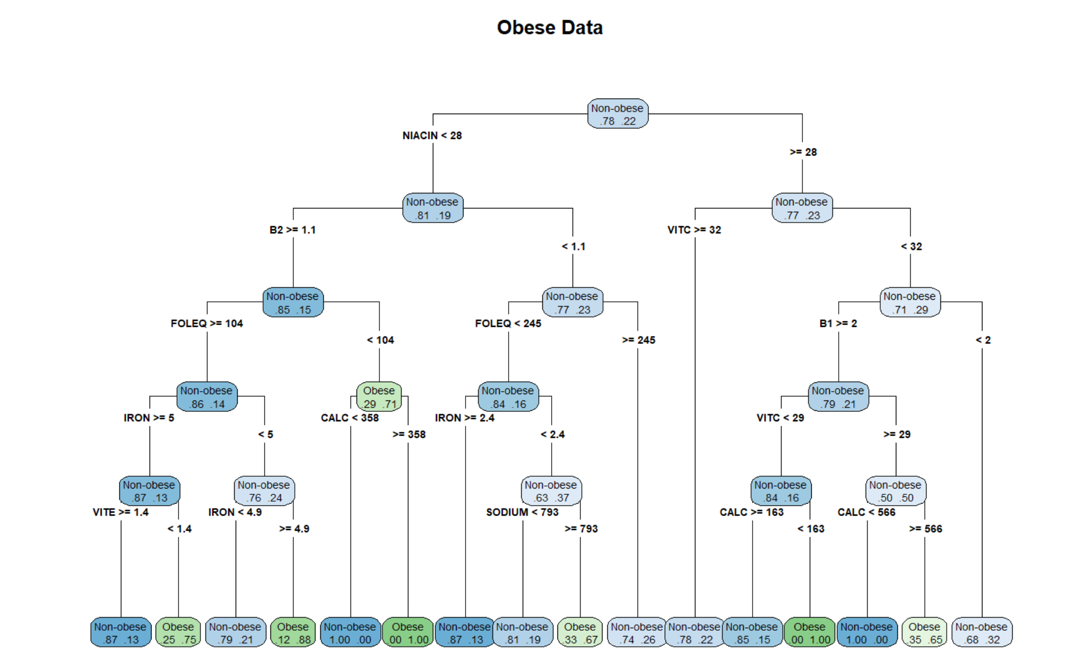
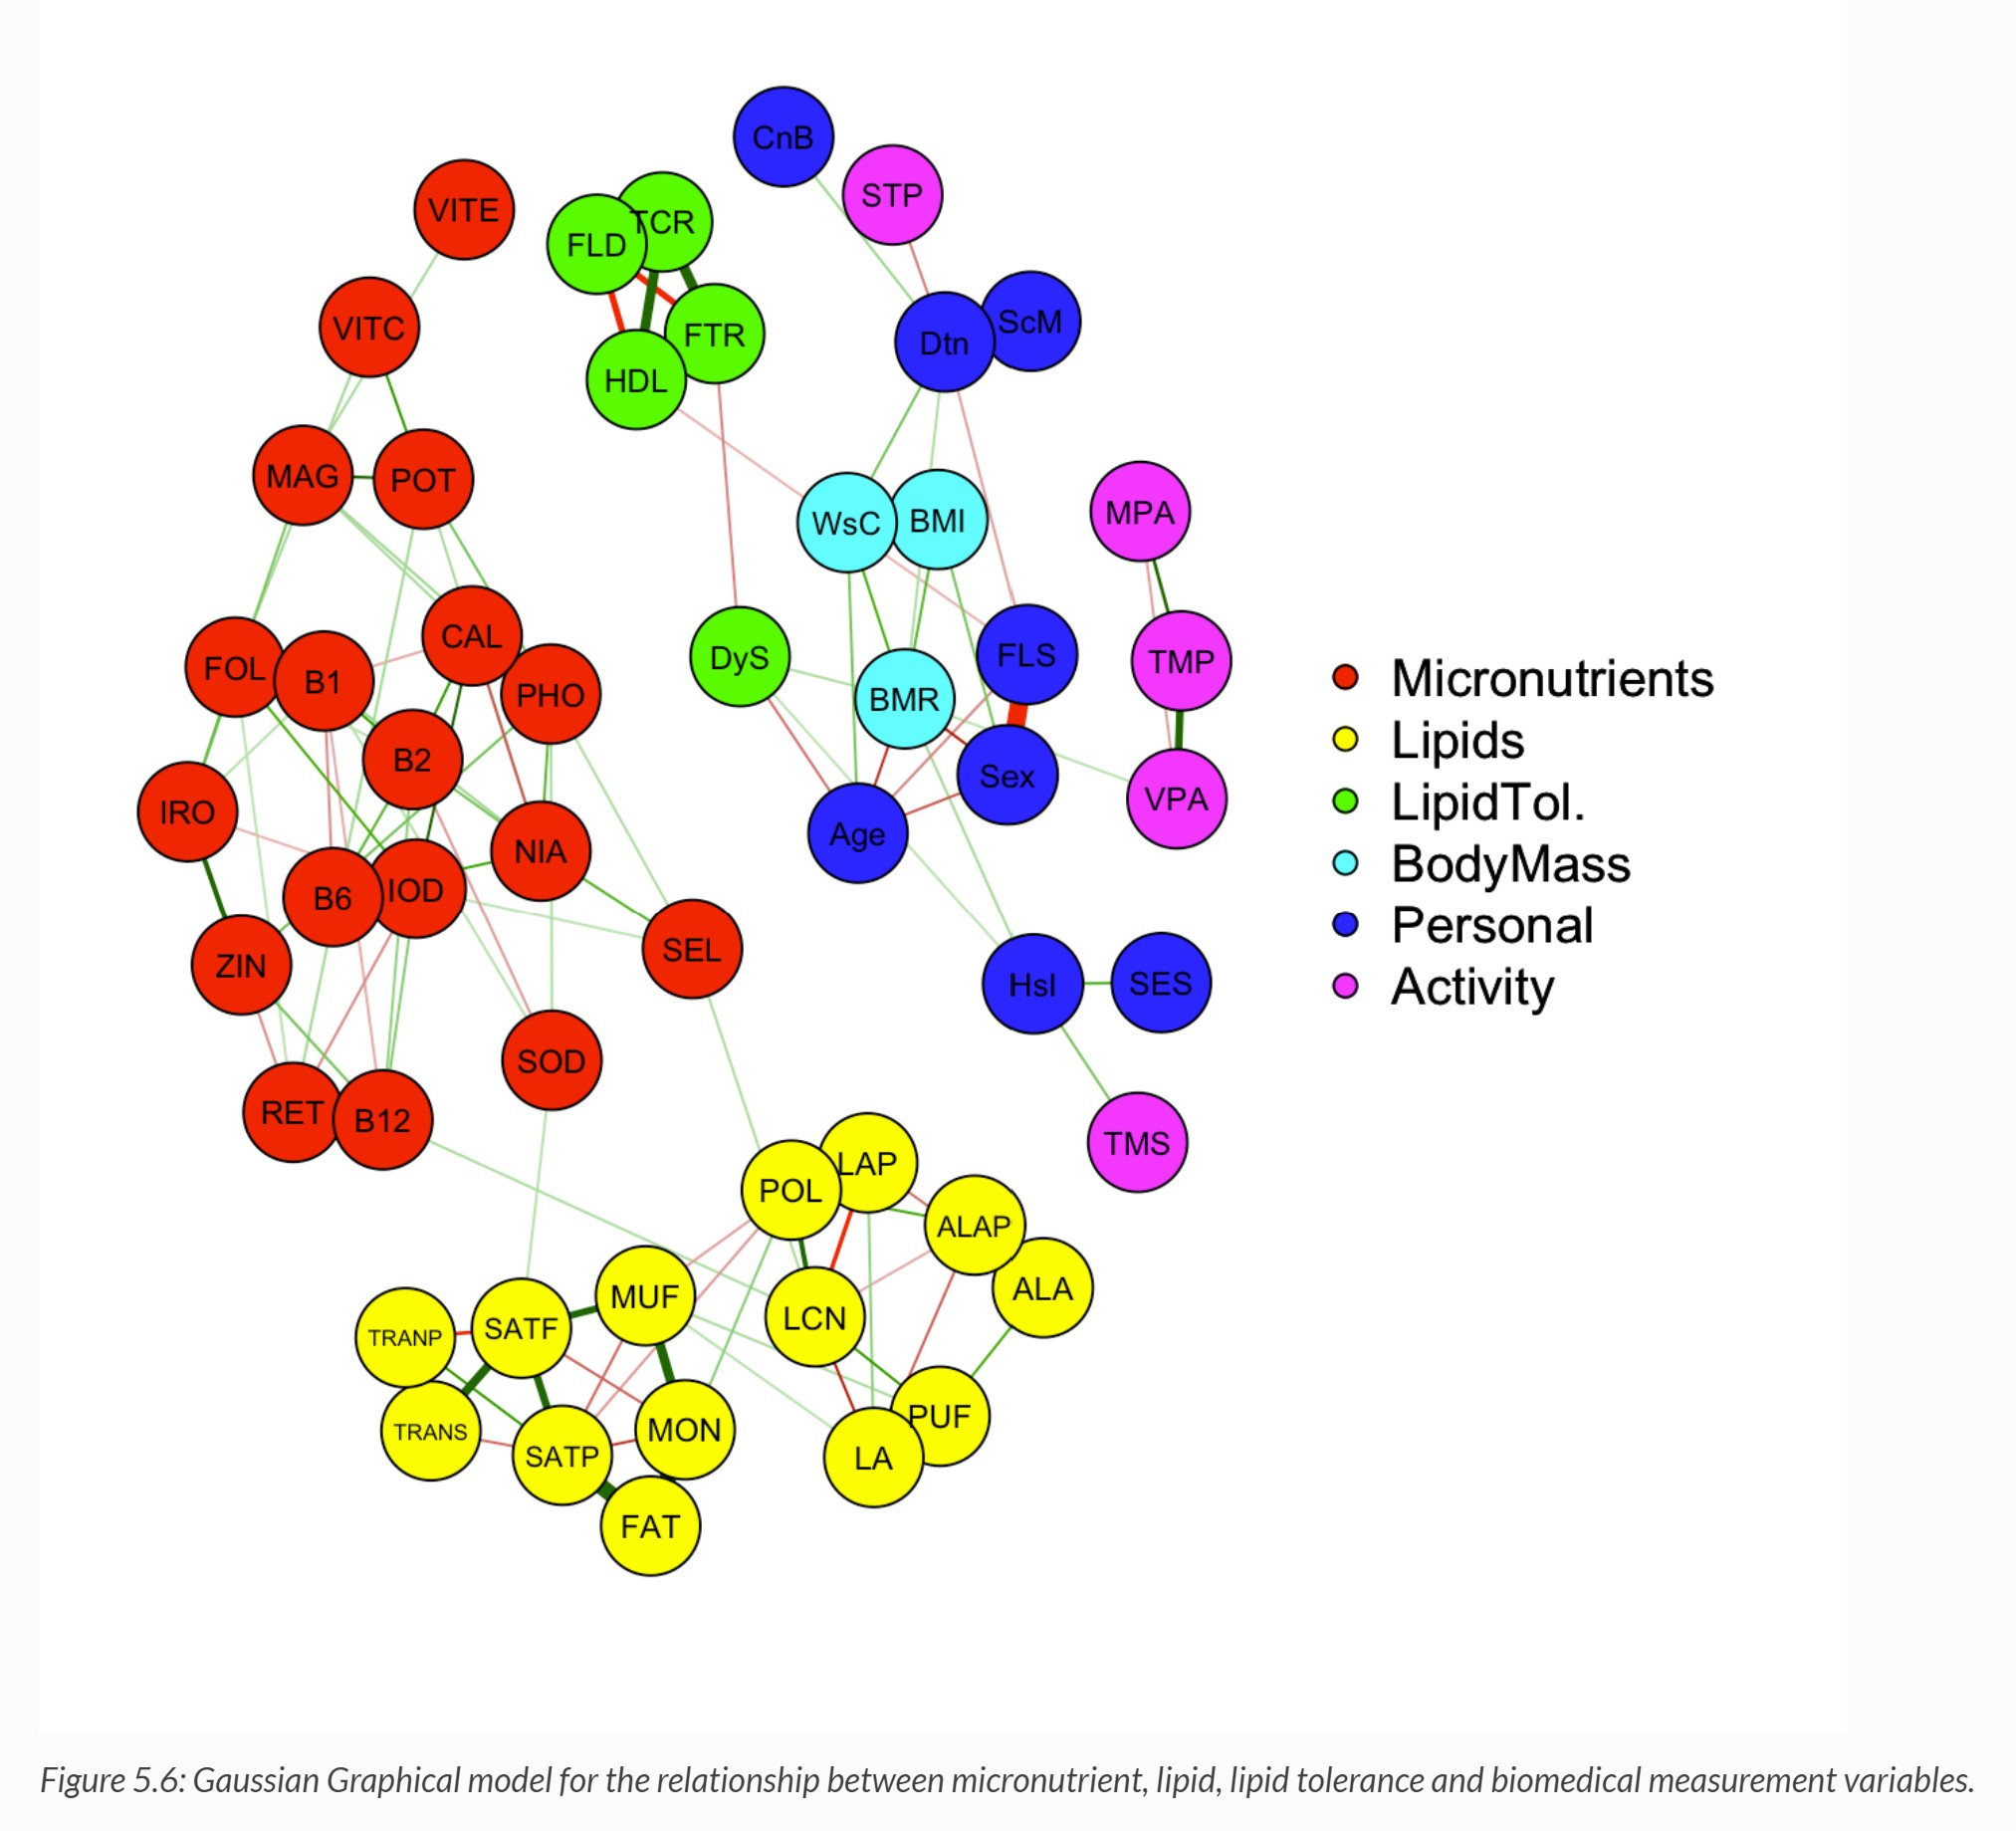

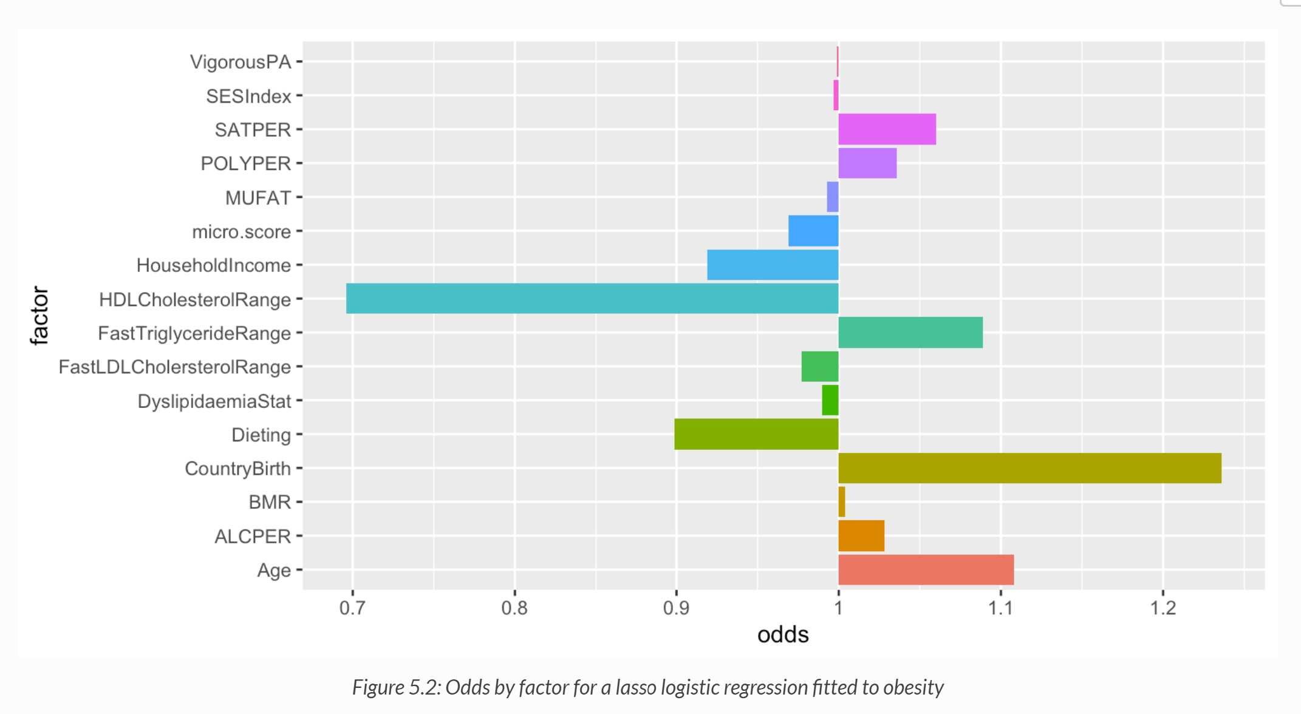

Stat1: Here are some selected visualisations, from the tree, we see how different quantities of micronutrients classify obese and non-obese individuals.
Stat2: from the graphical model, the red nodes and yellow nodes show both positive and negative correlations between different micronutrients and between good and bad fats.
Stat1: From the odds graph, triglycerides increase the odds of obesity and although cholesterol strangely decreases the odds, HDL decreases these odds more than LDL.

Slide 4
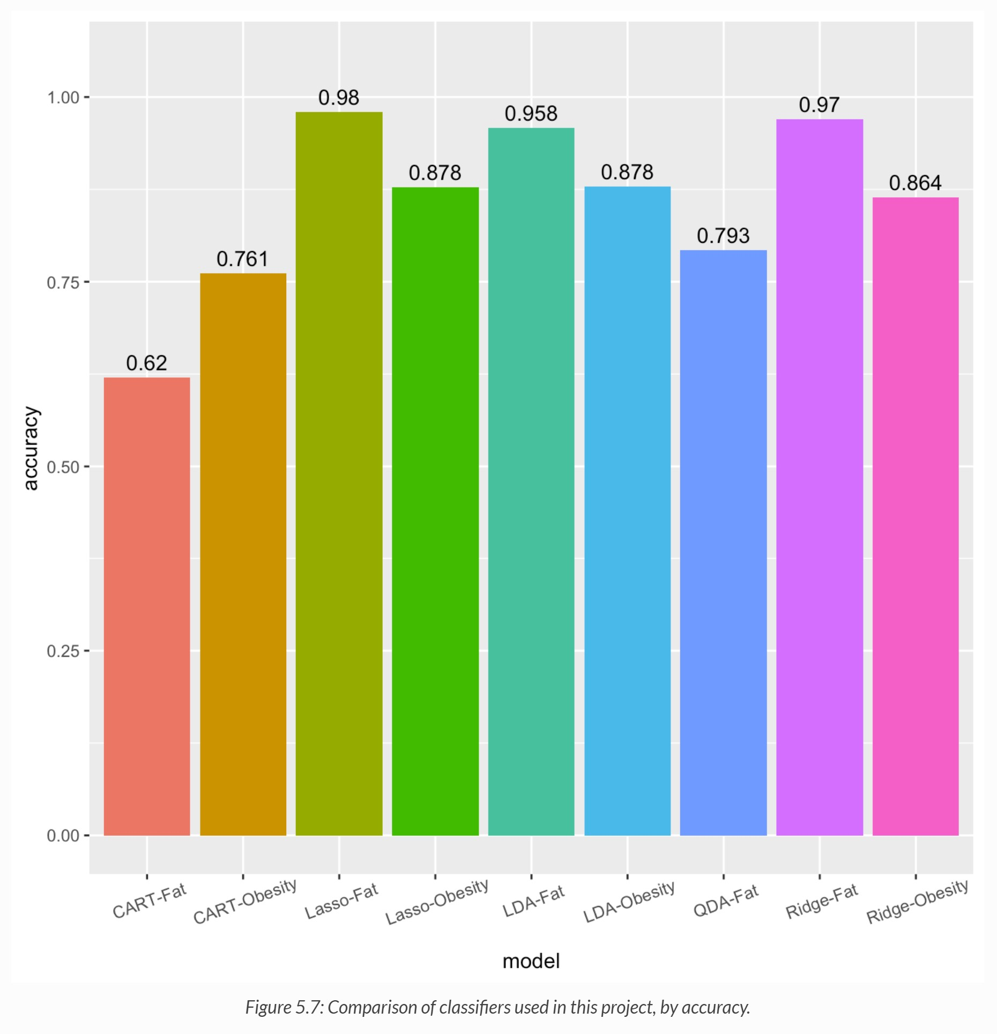
Model
Accuracies
Stat2: Our model accuracies were quite good as well, they’re generally around 70-90%.

Slide 5
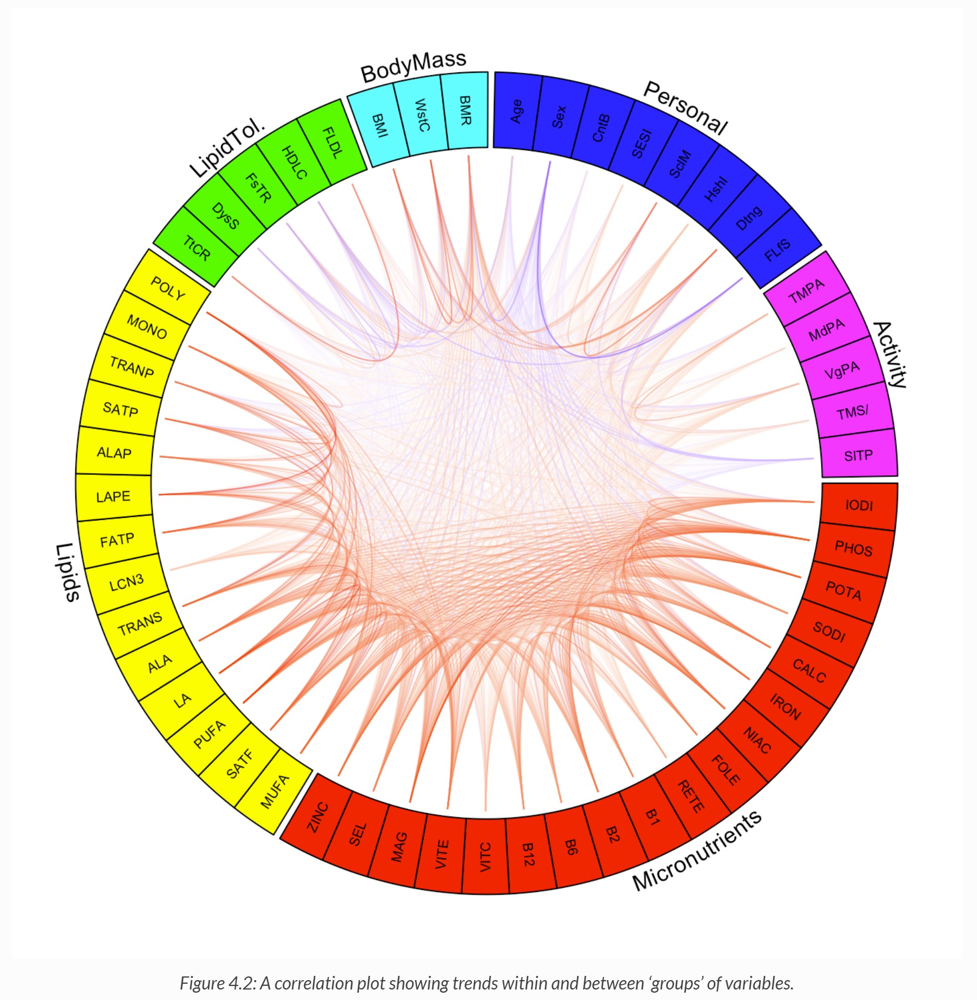
Implications & Future Directions
MC: Those are some very interesting findings! Could you elaborate on the significance of this study and any shortcomings?
Liptol: Our aim was really to bridge gaps in the literature regarding micronutrients and fat metabolism, as literature has been pretty inconsistent.
Fat: I’ve heard from our statisticians that although generally consistent, there were also minor inconsistencies between some of our models.
Stat1: Although we included control variables in the logistic regressions, we had trouble with multicollinearity and class imbalance.
Stat2: To simplify our models, we modelled on the assumption that lipids and micronutrients were independent of other macronutrients and environmental factors.
Micro: However, this modelling assumption is undesirable since physiological processes and external factors are interdependent, future studies could model how these factors complement this study.
MC: So I guess we should be more hesitant when trying to draw more holistic dietary recommendations from this study, however the study could contribute to future interventions regarding obesity. So that is all that we have time for today. Can we put our hands together for a round of applause for our lovely panelists. I now invite any further questions.

Slide 6
Questions?
The panel is now open for questions.

Slide 7
Appendix

Slide 8
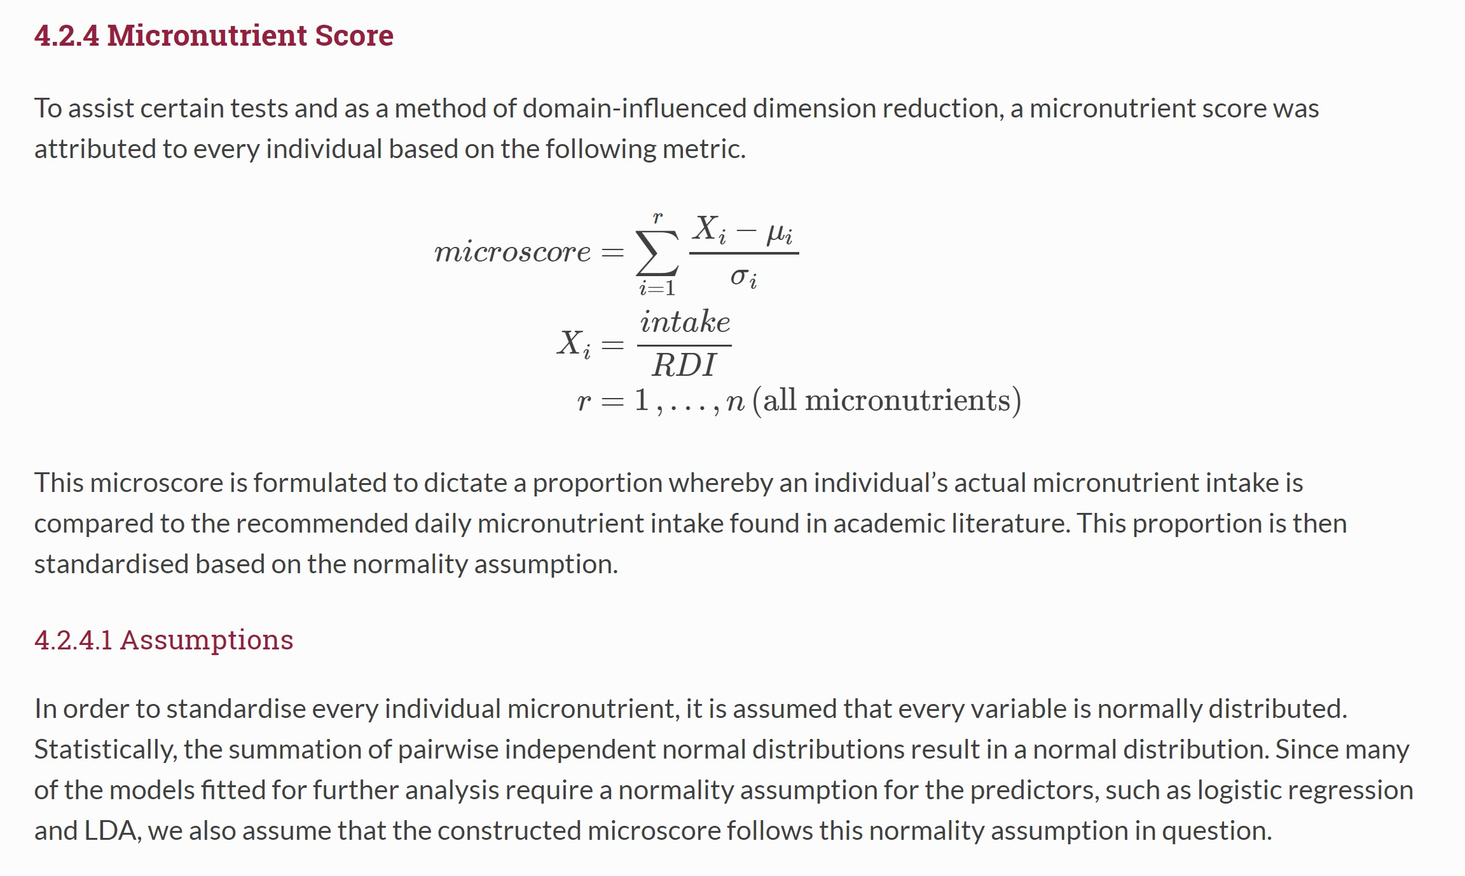
Microscore

Slide 9
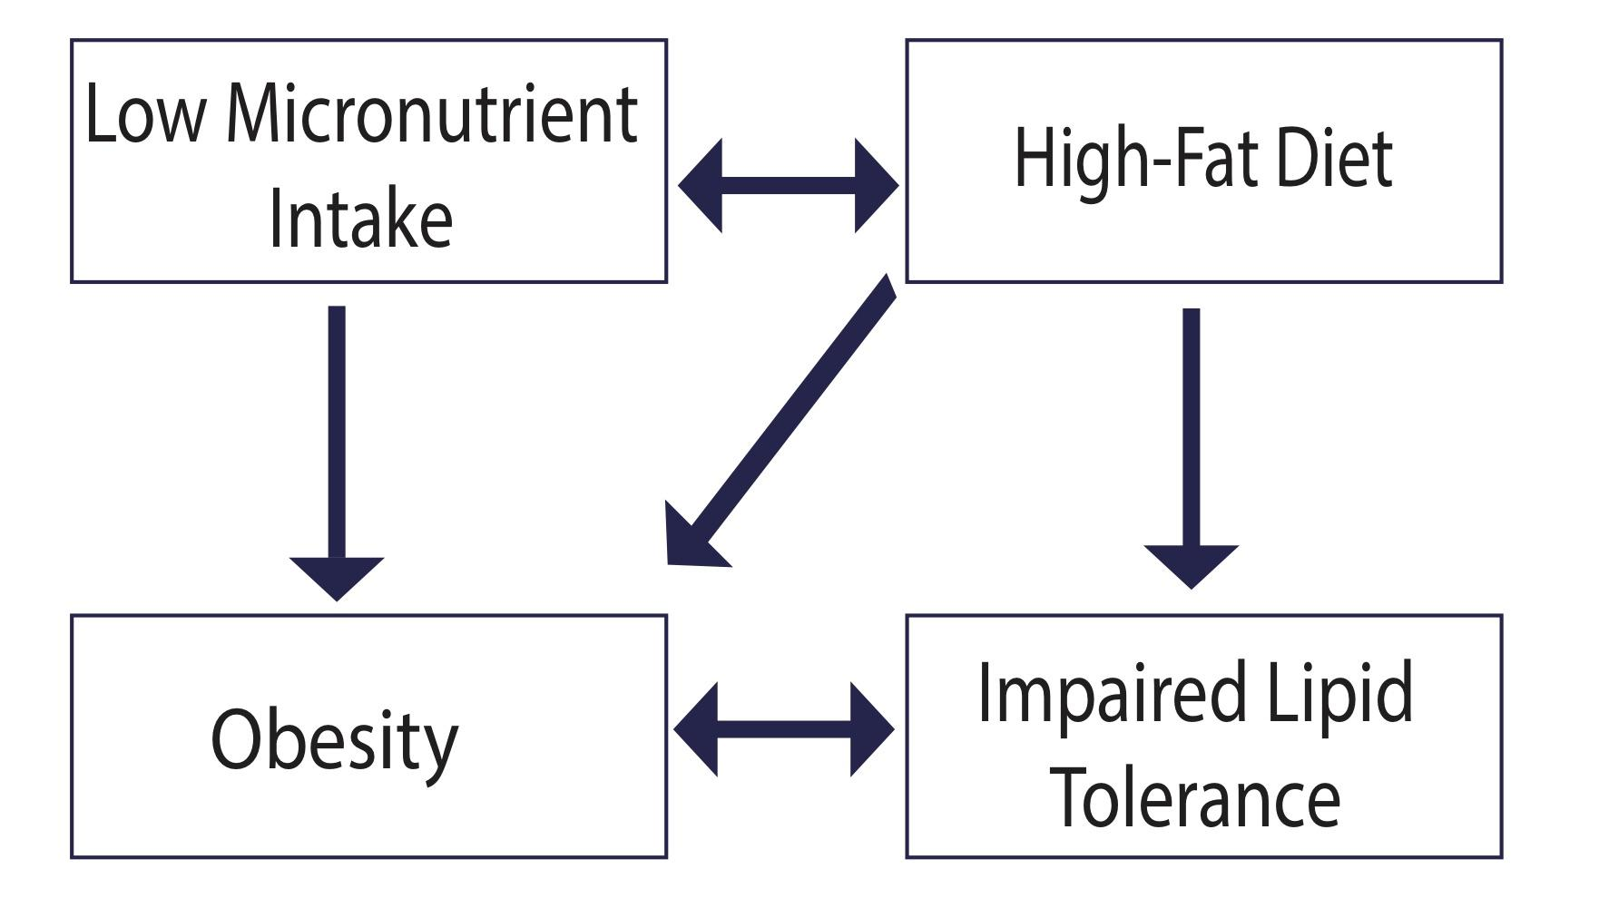
Summary of results

Slide 10
Data Treatment
Actions taken on sub-populations
Restricting the age to 21 – 65 years old | different BMI measurement standard i.e. Ages 2 years and older use the CDC growth chart percentile standard; Ages 0 to 2 use the WHO growth charts.
Removing under-reporters according to the Goldberg cut-off | Including under-reporters would create biases in our data: Under-reporting appears to be more prevalent amongst females than males, the practice appears to increase with age, and appears to increase as BMI increases (ABS.gov.au, 2014).
Removing pregnant and breastfeeding women | Atypical physiological and metabolic requirements as they require modified micronutrient and lipid intake
Removing individuals who are on a diet | personalised a diet plan catered specifically to their own unique needs which cannot be indicative of the general population.

Slide 11
Considerations | Issues
Day T1/T2 Measurements Errors, Outliers and Missing values | Missing values: For individuals who provided nutrient data for days 1 and 2, the means of the two days were computed for further analysis. For individual who only provided data for 1 day, the value for that day was used. Errors and Outliers: From a careful exploration of the raw data, errors and outliers in AHS11nutrient dataset was discovered. For example, for ABSPID: NPA11B10037391, according to the AHS11nutrient dataset, they consumed 6761.37 and 0.86ug of B12 on days 1 and 2 respectively, however, according to food, they consumed 1.38 and 0.86 ug of B12 on days 1 and 2 respectively. Therefore the food dataset was collapsed as a new dataset for the nutrient data.
Micronutrients | After engaging domain expertise, certain micronutrients were collapsed. Of particular relevance is all the folate compounds were combined into FOLEQ and ProVitamin A and PreVitamin A were combined into RETEQ and niacin and vitamin B3 was combined into NIACIN. Outliers: Certain micronutrient measurements which were 10-12 times the recommended daily intake were retained and not omitted as outliers. Although they are high, they are not infeasible.
Outliers, Data Errors and Missing values

Slide 12
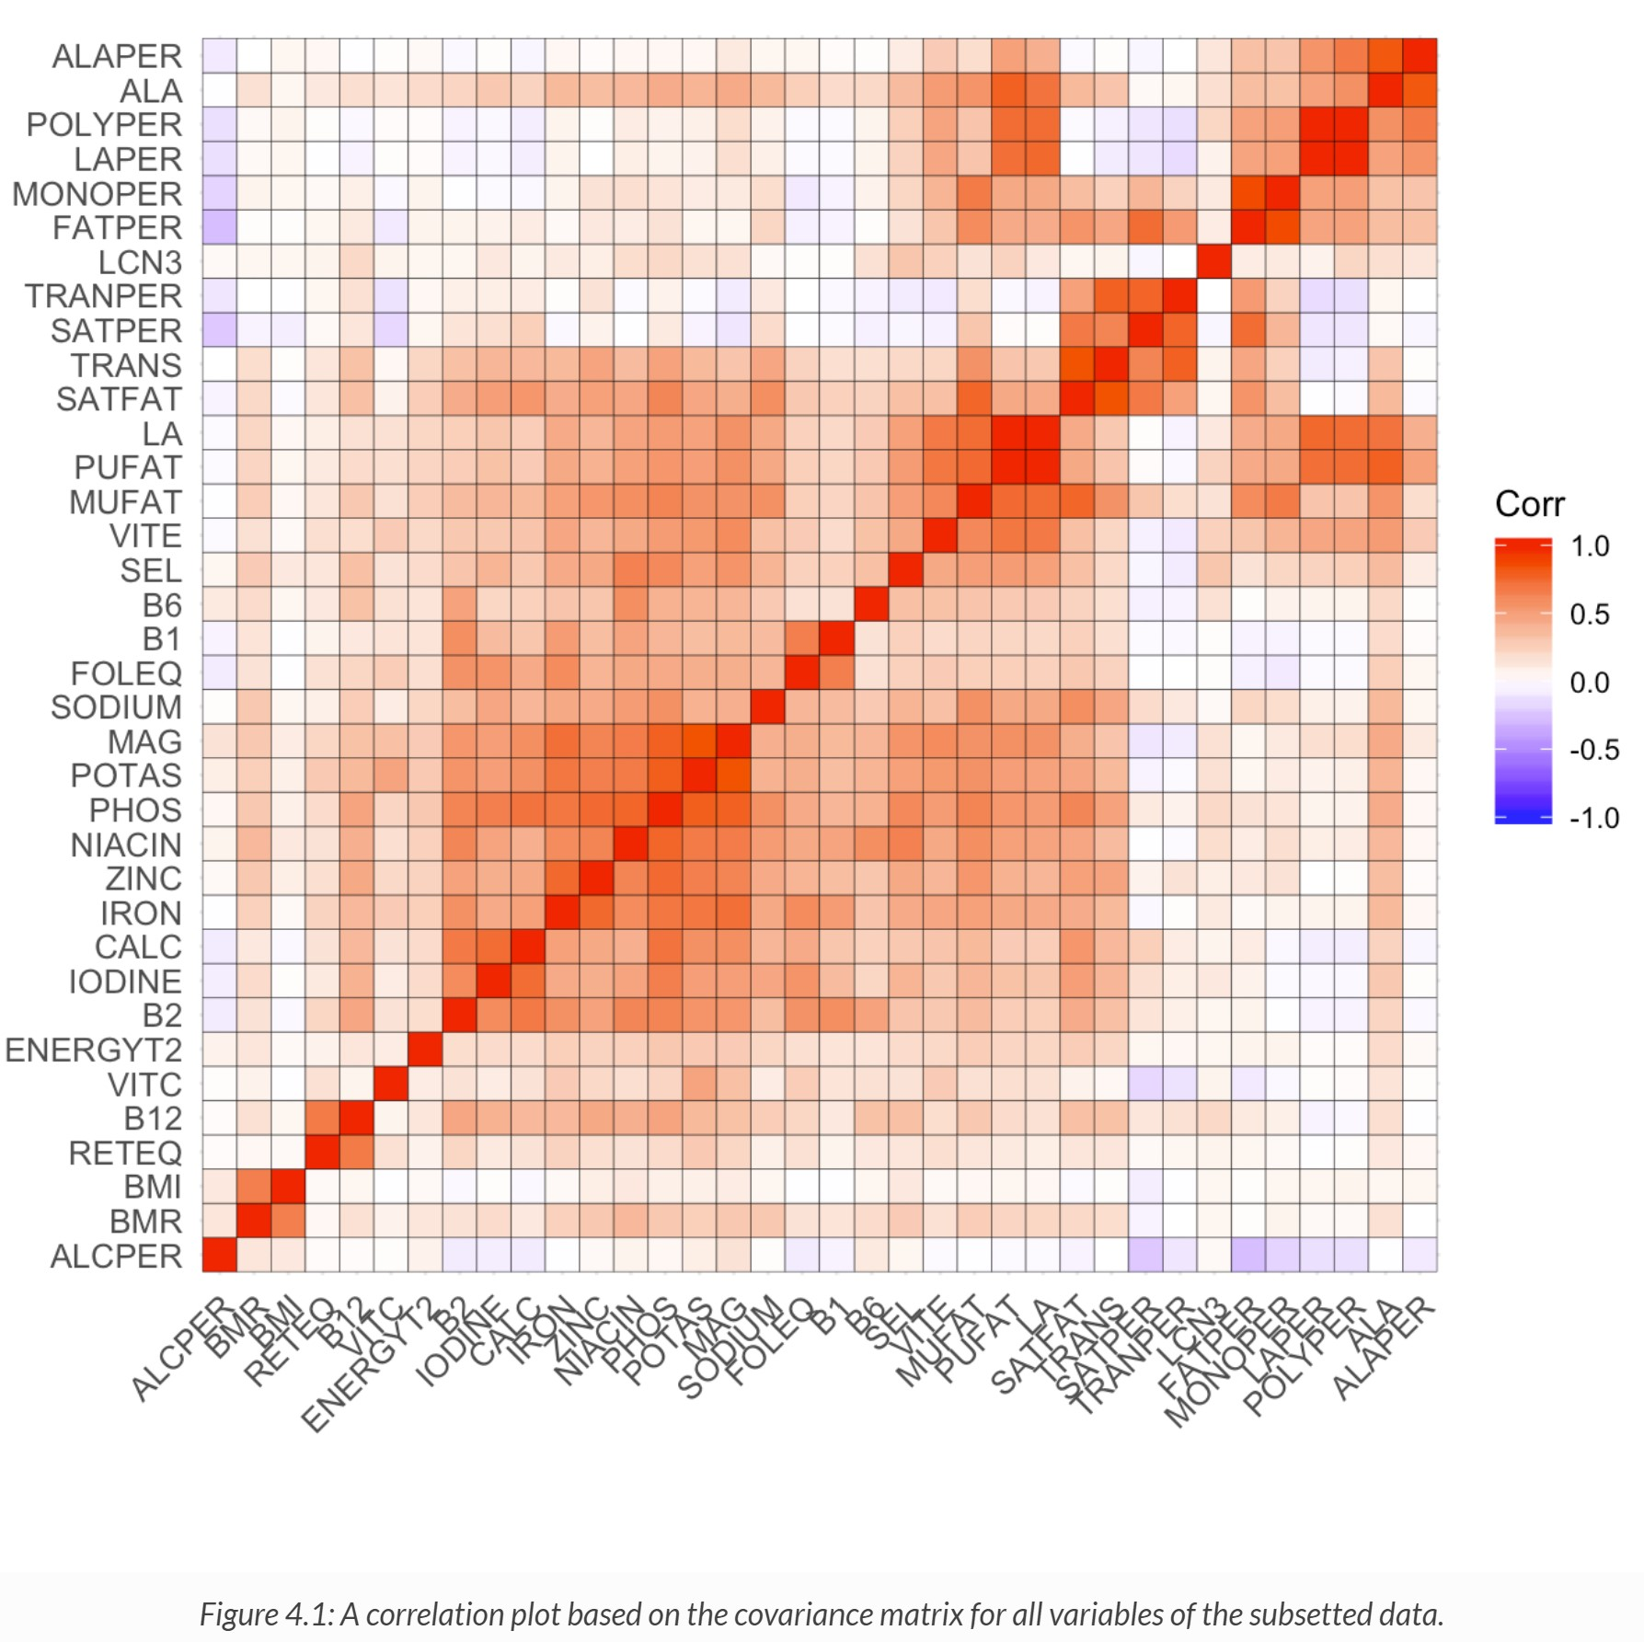
Correlation plot

Slide 13
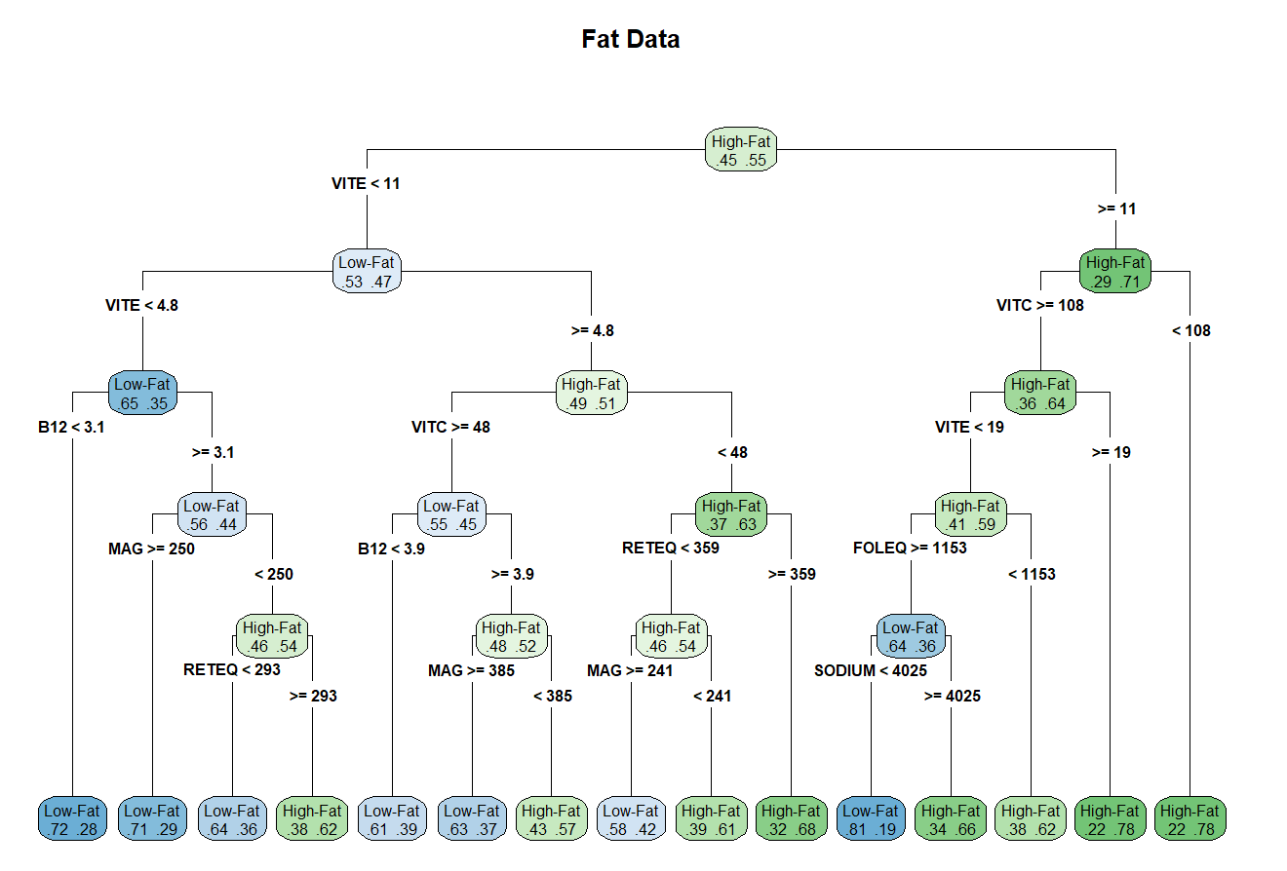
CART (FATPER)

Slide 14
CART (BMI)

Slide 15
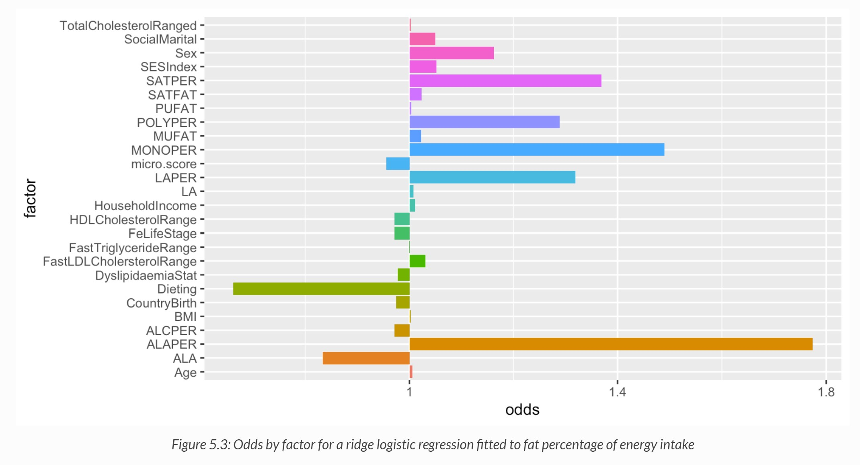
Ridge Regularisation + Logistic regression (FATPER)

Slide 16
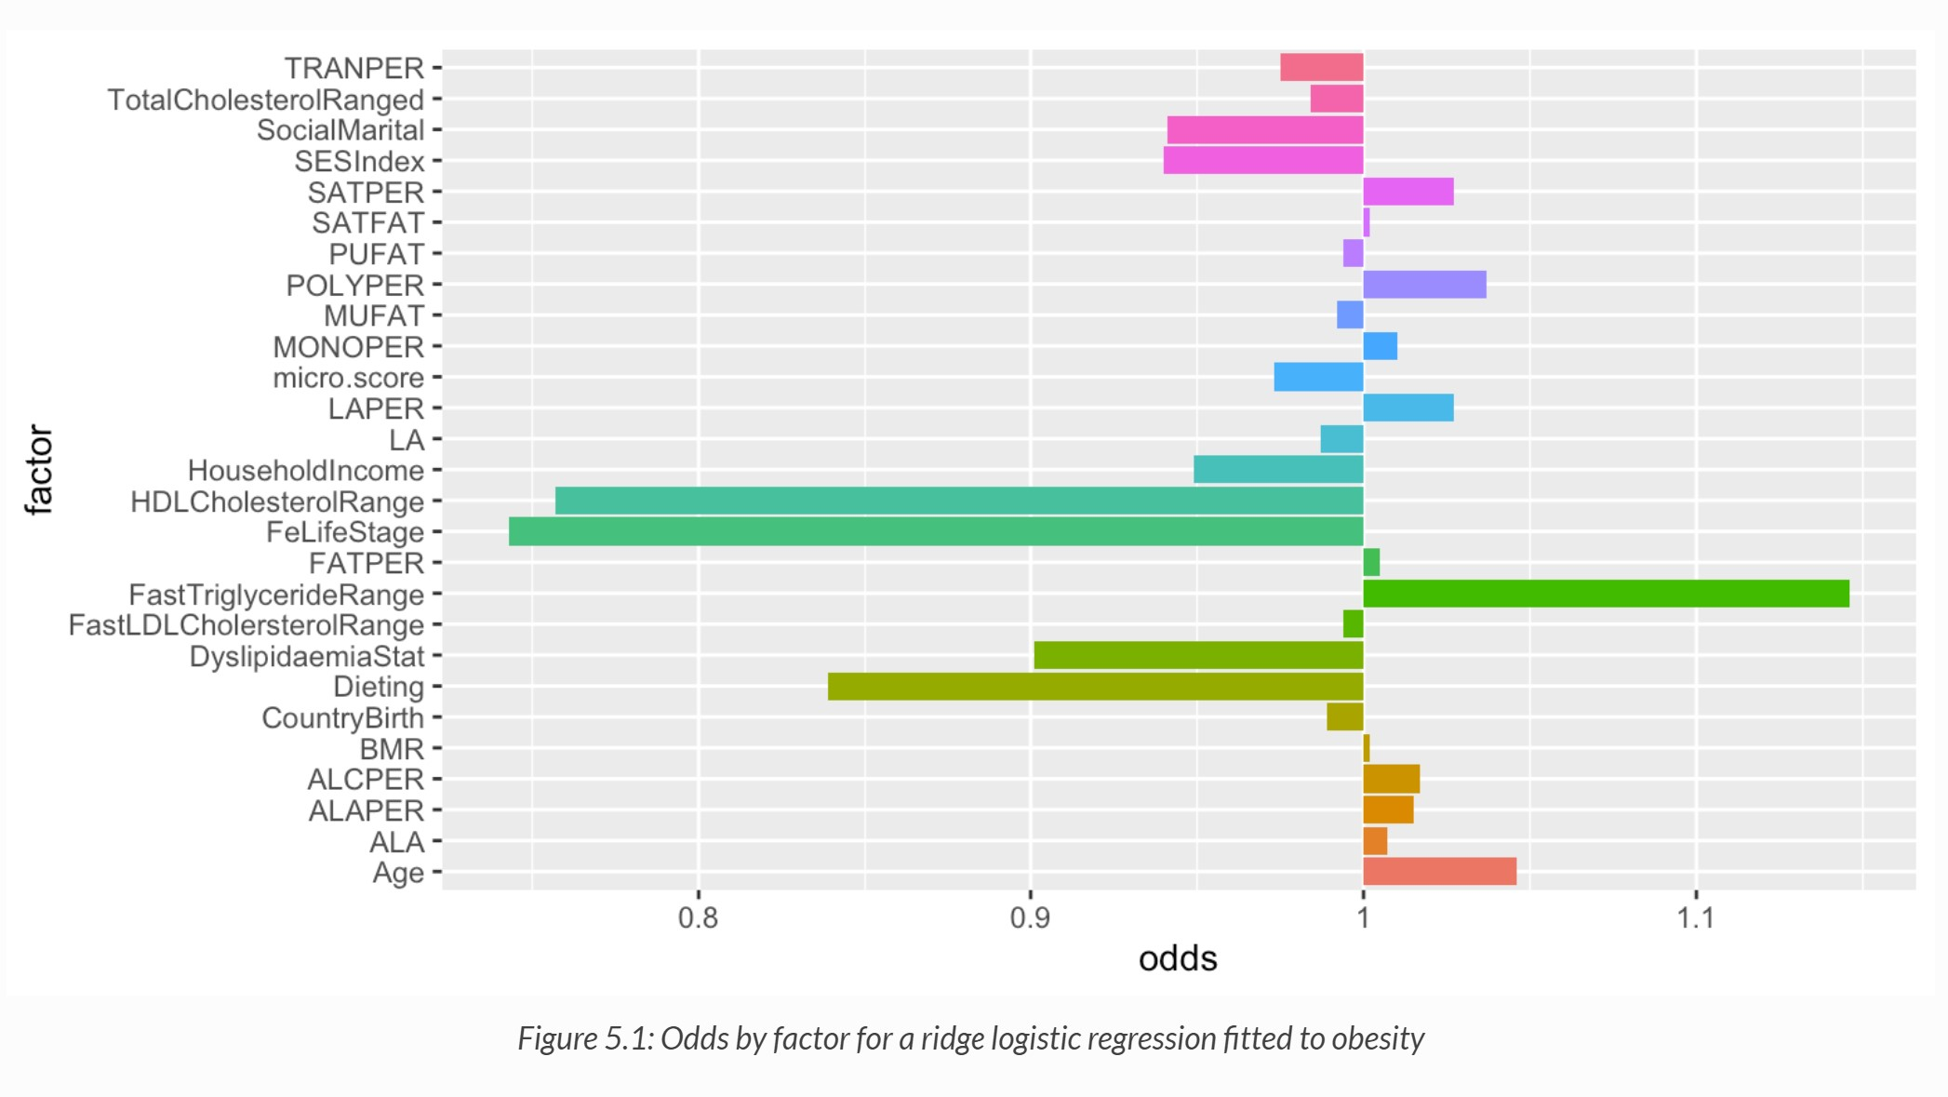
Ridge Regularisation + Logistic regression (BMI)

Slide 17
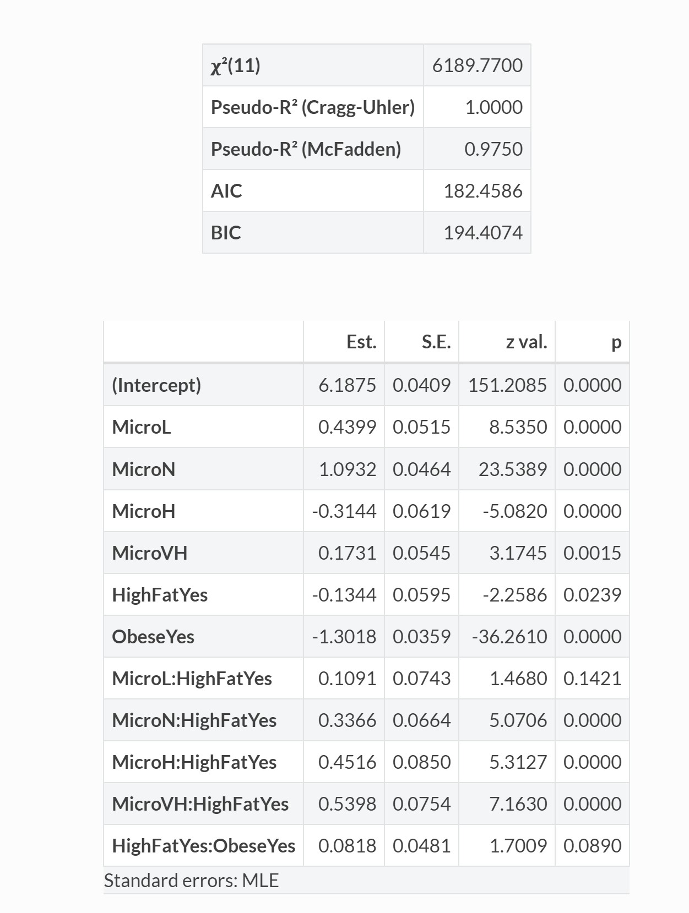
Log-Linear Model

Slide 18
Gaussian Graphical model

Slide 19
What is Micronutrient Dilution?
Micronutrient dilution refers to the circumstance where a diet high in sugar or energy-dense foods compromises micronutrient intake.
Given micronutrients play integral roles in various metabolic processes, if multiple micronutrient deficiencies are present this can result in a significantly reduced capacity of the body to efficiently utilize these calories.
This can lead to a build-up of toxic by-products inducing further weight gain, mental health issues and disease.
For example, deficiencies in vitamin B12 and folate lead to hyperhomocysteinemia, a risk factor for atherosclerosis.
Previous studies have mostly explored micronutrient dilution in comparison with excess total energy and excess sugar intake. Given energy-dense diets tend to be high in fat, the current study explored whether a relationship exists between micronutrient and fat intake.
References: Aytekin et al., 2019; Mok et al., 2018; Kaider-Person et al., 2008

Slide 20
What is Lipid Tolerance?
Impaired lipid tolerance refers to a reduction in the efficiency in which an individual metabolises and utilises lipids in the body.
Abnormalities in lipid metabolism usually occur when energy intake exceeds adipose tissue storage capacity, an event common in obese individuals
Hypertriglyceridemia and hypercholesterolaemia are both forms of dyslipidemia that arise from aberrant lipid metabolism, resulting in clinical representations of increased LDL cholesterol, increased serum triglycerides and decreased HDL cholesterol
References: Febrinati et al., 2012; Morentin Gutierrez et al., 2019; Walker and Crook, 2013

Slide 21
Rationale of Our Study
Obesity is complex, multifaceted condition so it is crucial that research attempts to capture this through examining relationships between multiple variables.
While previous studies have explored total energy and sugar on micronutrient dilution, researchers have yet to investigate the relationship between micronutrient and dietary fat intake.
Obesity significantly contributes to the development of cardiovascular disease through altering lipid tolerance. Emerging evidence also suggests lipid tolerance is affected by dietary patterns.
Exploring how different dietary factors interact together and contribute to obesity and lipid tolerance could inform future public health interventions.

Slide 22
Statistical Questions
Are different lipids intakes, lipid tolerance measurements and micronutrients intake good predictors of obesity in the general Australian population?
How do micronutrients, different lipid intake (i.e. MUFAT, PUFAT, SATFAT, TRANFAT) and lipid tolerance classify total energy derived from fats (FATPER) in the general Australian population?
Is there a significant relationship between lipids intake, micronutrient intake and lipid tolerance measurements with obesity in the general Australian population?
Is there a significant relationship between different lipids (i.e. MUFAT, PUFAT, SATFAT, TRANFAT), micronutrient intake and lipid tolerance measurements with the individual’s total energy derived from fat (FATPER) in the general Australian population?
Are there significant interaction effects between micronutrient intake, total energy derived from fat and BMI in the general Australian population?

Slide 23
How does the findings about nutrients and obesity align with literature?
Obese individuals tend to have a lower intake of multiple micronutrients, including B-group Vitamins, magnesium, iron and calcium.
Micronutrient dilution has been described in obese individuals, where there is a greater consumption of energy-dense foods with a concurrent lower micronutrient intake (Mok et al., 2018; Aytekin et al., 2019).
Low micronutrient consumption is also associated with weight gain, given many micronutrients are co-factors in metabolic processes (Aytekin et al., 2019).
Odds of micronutrient intake increases with a low-fat diet (<30% of total energy from fat).
This is likely due to the abundance of micronutrients in naturally low-fat containing foods (Shay et al., 2012).
Saturated fats have been positively correlated with BMI whereas unsaturated fats have been negatively correlated with BMI.
This findings align with an abundance of literature and previous cross sectional studies (Shay et al., 2012; Halade et al., 2012)
Saturated fatty acids contribute to postprandial inflammation, which reduces the activity of lipoprotein lipase, resulting in greater storage of lipids and increasing adiposity which can be reflected in the BMI score (Klop et al., 2013).

Slide 24
How does the findings about nutrients and lipid tolerance align with literature?
There was a positive association between micronutrient intake and impaired lipid tolerance.
This is inconsistent with literature, as impaired lipid tolerance is typically associated with micronutrient deficiency since many micronutrients play an essential role in lipid metabolism (Fidanza & Audisio, 1982; Jacqmain et al., 2003).
However, the relationship between multiple micronutrients and lipid tolerance has not been examined in the Australian population before.
When impaired lipid tolerance is present, the likelihood of a high-fat (>30% total energy from fat) is greater.
Previous studies examining the relationship between dietary fat and lipid tolerance have presented inconsistent findings.
An analysis of the Australian Health Survey 2011-13 found no difference in consumption of saturated fat, trans fat, polyunsaturated fat and total fat between adults with CVD, at risk of CVD or with no CVD - markers of which include impaired lipid metabolism (Thomas et al., 2017).

Slide 25
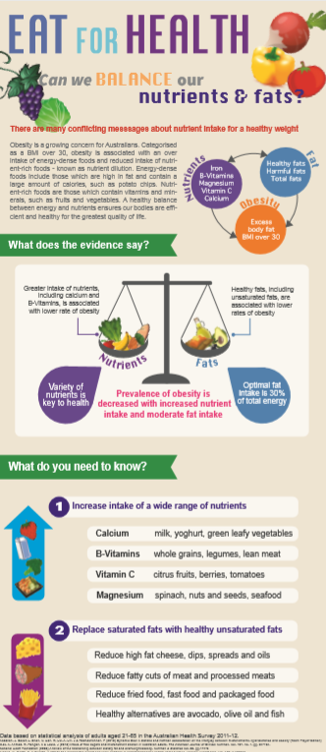

Slide 26


Group highlights and Appreciations Page

Slide 27
References
Guerci, B, Paul, J, Vergès, B, Drouin, P, Durlach, V & Hadjadj, S (2000) Lack of association between lipaemia and central adiposity in subjects with an atherogenic lipoprotein phenotype (ALP). International Journal of Obesity, Vol. 24, no. 9, pp. 468-478.
Halade, GV, Jin, YF & Lindsey, ML (2012) Roles of saturated vs. polyunsaturated fat in heart failure survival: not all fats are created equal. Cardiovascular Research. Vol. 93. pp. 4-5.
Harris, M (2013) The metabolic syndrome. Australian Family Physician, Vol. 42, no. 8, pp. 524-527.
Hofmann, S, Perez-Tilve, D, Greer, T, Coburn, B, Grant, E, Basford, J, Tschop, M & Hui, D (2007) Defective Lipid Delivery Modulates Glucose Tolerance and Metabolic Response to Diet in Apolipoprotein E Deficient Mice. Diabetes, Vol. 57, no. 1, pp. 5-12.
James, PT, Leach, R, Kalamara, E & Shayeghi, M (2001) The worldwide obesity epidemic. Obesity Research, Vol. 9(5), pp. S228-S233.
Jacqmain, M., Doucet, E., Després, J., Bouchard, C. and Tremblay, A (2003) Calcium intake, body composition, and lipoprotein-lipid concentrations in adults. The American Journal of Clinical Nutrition, Vol. 77, no. 6, pp. 1448-1452.
Joffe, YT, Merwe, LVD, Evans, J, Collins, M, Lambert, EV, September, AV & Goedecke, JH (2014) Interleukin-6 Gene Polymorphisms, Dietary Fat Intake, Obesity and Serum Lipid Concentrations in Black and White South African Women. Nutrients. Vol.6, pp. 2436-2465.
Kaidar-Person, O, Person, B, Szomstein, S & Rosenthal, R (2008) Nutritional Deficiencies in Morbidly Obese Patients: A New Form of Malnutrition? Part B: Minerals. Obesity Surgery, Vol. 18, no. 8, pp. 1028-1034.
Klop, B, Elte, JWF & Cabezas MC (2013) Dyslipidemia in Obesity: Mechanisms and Potential Targets. Nutrients. Vol. 5, pp. 1218-1240.

Slide 28
References
ABS.gov.au. (2014). Australian Health Survey: Users' Guide, 2011-13. [online] Available at: https://www.abs.gov.au/ausstats/abs@.nsf/Lookup/4363.0.55.001Chapter651512011-13 [Accessed 26 Oct. 2019].
Röhrl, C. and Stangl, H., 2018. Cholesterol metabolism—physiological regulation and pathophysiological deregulation by the endoplasmic reticulum. Wiener Medizinische Wochenschrift, 168(11-12), pp.280-285.
Aytekin, N, Godfri, B, & Cunliffe, A (2019) The hunger trap hypothesis: New horizons in understanding the control of food intake. Medical Hypotheses, Vol. 129, p.109247.
Beaudoin, M, Robinson, L & Graham, T (2011) An Oral Lipid Challenge and Acute Intake of Caffeinated Coffee Additively Decrease Glucose Tolerance in Healthy Men. The Journal of Nutrition, Vol. 141, no. 4, pp. 574-581.
Cvijanovic, N, Isaacs, NJ, Rayner, CK, Feinle-Bisset, C, Young, RL &amp; Little, TJ (2017) Lipid stimulation of fatty acid sensors in the human duodenum: relationship with gastrointestinal hormones, BMI and diet, International Journal of Obesity, Vol. 41, pp. 233-239.
Da Silva, R, Kelly, Al Rajabi, A & Jacobs, R (2013) Novel insights on interactions between folate and lipid metabolism. BioFactors, Vol. 40, no. 3, pp. 277-283.
Febrianti, ESZ, Asviandri, Farlina, L, Lestari, R, Cahyohadi, S, & Rini, EA (2012) Correlation between lipid profiles and body mass index of adolescents obesity in Padang, International Journal of Pediatric Endocrinology, pp. 87.
Fruhbeck, G, Gomez-Ambrosi, J, Muruzabal, FJ, Burrell, MA (2001) The adipocyte: a model for integration of endocrine and metabolic signalling in energy metabolism regulation. American Journal of Physiology: Endocrinol and Metabolism, Vol. 280, pp. E827- E847.

Slide 29
References
Must, A, Spadano,J, Coakley,EH, Field,AE, Graham,C & Dietz, WHJ (1999) The disease burden associated with overweight and obesity. JAMA, Vol. 282, no.16, pp.1523-1529.
Mok, A, Ahmad, R, Rangan, A & Louie, J (2018) Intake of free sugars and micronutrient dilution in Australian adults. The American Journal of Clinical Nutrition, Vol. 107, no. 1, pp. 94-104.
National Heart Foundation (2003) A review of the relationship between dietary fat and overweight/obesity. Heart Foundation.
Okura, T, Nakamura, R, Fujioka, Y, Kawamoto-Kitao, ., Ito, Y, Matsumoto, K, Shoji, K., Sumi, K, Matsuzawa, K, Izawa, S, Ueta, E, Kato, M, Imamura, T, Taniguchi, S & Yamamoto, K (2018) Body mass index ≥23 is a risk factor for insulin resistance and diabetes in Japanese people: A brief report. PLOS ONE, Vol. 13, no. 7, pp.e0201052.
Phillips, CM, Kesse-Guyot, E, McManus, R, Hercberg, S, Lairon, D, Planells, R & Roche, HM. (2012) High Dietary Saturated Fat Intake Accentuates Obesity Risk Associated with the Fat Mass and Obesity–Associated Gene in Adults. The Journal of Nutrition. Vol.142(5), pp.824-31.
Racette, SB, Deusinger, SS & Deusinger, RH (2003) Obesity: Overview of Prevalence, Etiology, and Treatment. Physical Therapy, Vol. 83, no.3, pp. 276-288.
Raynor, HA & Epstein, LH (2001) Dietary variety, energy regulation, and obesity. Psychol Bull, Vol. 127, no.3, pp. 325–341.
Shay, C, Van Horn, L, Stamler, J, Dyer, A, Brown, I, Chan, Q, Miura, K, Zhao, L., Okuda, N., Daviglus, M & Elliott, P (2012) Food and nutrient intakes and their associations with lower BMI in middle-aged US adults: the International Study of Macro-/Micronutrients and Blood Pressure (INTERMAP). The American Journal of Clinical Nutrition, Vol. 96, no. 3, pp. 483-491.

